Slide 1
L6_Complexity Classes
Dr. Jay Dave
CSIS Dept, Hyderabad Campus

Slide 2
Data Structures and Algorithms Design (Merged-SEZG519/SSZG519)
L6_Complexity Classes

Slide 3
Content of L-6
6.1. Definition of P and NP classes and examples
6.2. Understanding NP-Completeness
6.2.1. NP-Hardness
6.2.2. Polynomial time reducibility
6.2.3. Cook-Levin theorem
6.2.4. Problems in NP-Complete and using polynomial time reductions
6.2.4.1. CNF-SAT, 3-SAT
6.2.4.2. Vertex Cover
6.2.4.3. Clique and Set-Cover
6.2.4.4. Subset-Sum and Knapsack
6.2.4.5. Hamiltonian Cycle and TSP

Slide 4
Computational Complexity
Computational complexity refers to the study of the resources required by an algorithm to solve a particular computational problem as a function of the problem's input size.
Which resources??
Time
Space

Slide 5
Space Complexity
Space complexity is a measure of the amount of memory space an algorithm uses concerning the size of the input.
Algorithm F(A[n]) int i for i = 1 to n A[i] ← 0 | Algorithm F(A[n]) int i, B[n] for i = 1 to n B[i] ← A[i] | Algorithm F(A[n]) int I, B[n, n] for i = 1 to n for j = 1 to n B[i,j] ← A[i] | Algorithm F(n) int i if n > 0 i ← n print i F(n-1)

Slide 6
Time Complexity
Time complexity is a measure of the amount of time an algorithm takes to complete concerning the size of the input.
We consider number of primitive operations to represent time complexity. (Recall Ch 1)

Slide 7
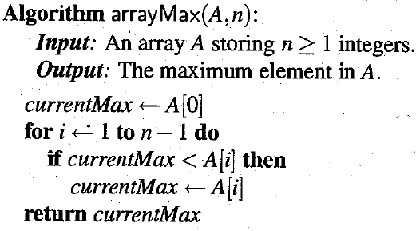
Time complexity
Counting Primitive Operations
1
n
n
0 to n
1

Slide 8
Time complexity
Name | Running time | Example
constant time | O(1) | 12, 10, 3 Print 2nd element of array Calculate (-1)^{n}
logarithmic time | O(log n) | Binary search
polylogarithmic time | O((log n)^m) | (log n)²
linear time | O(n) | 2n+1, n Find largest element in array
quadratic time | O(n²) | n² Print 2d matrix
cubic time | O(n³) | n³ Multiply two 2d matrices
polynomial time | O(n^{k}) | 2n²+3n, 4n³+1
exponential time | O(k^{n}) | 2^{n} + n² Solving matrix chain multiplication via brute-force search

Slide 9
Time Complexity
(A Research Problem)
Aim is to solve a problem with lower time complexity.
Polynomial → constant, Exponential → Polynomial.
Solve it using non-deterministic algorithm!!

Slide 10
Time Complexity
(A Research Problem)
Deterministic algorithm: A deterministic algorithm is an algorithm that, given a particular input and a particular set of initial conditions, will always produce the same output, with no randomness involved.
Non-deterministic algorithm: A nondeterministic algorithm is an algorithm that, in addition to deterministic steps, can make choices at certain points during its execution without specifying which choice to make.

Slide 11
Time Complexity
(A Research Problem)
Algorithm Search(A, n, Key)
index ← choice()
if A[index] = key then
Print(index)
Success()
Failure()

Slide 12
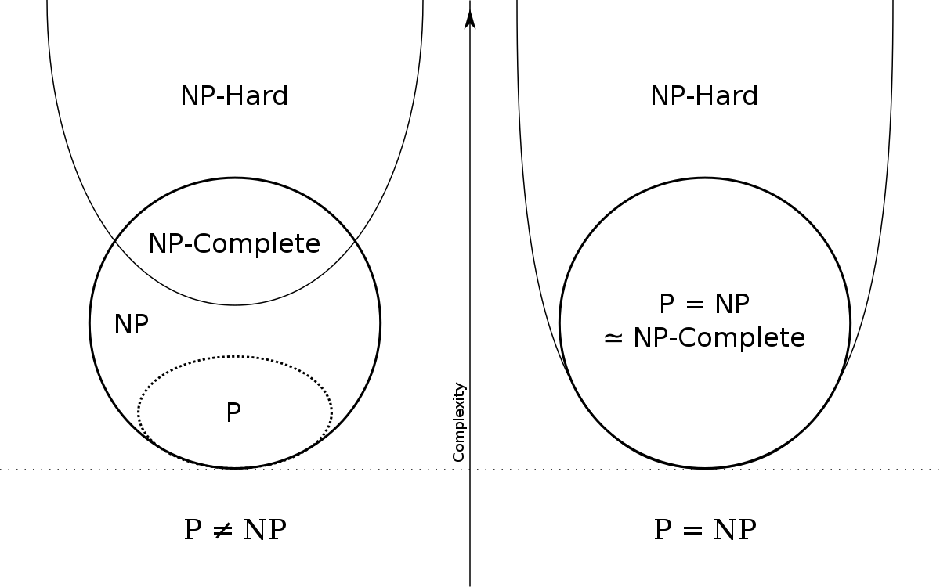
Time Complexity
(A Research Problem)

Slide 13
Time Complexity
(A Research Problem)
Too many NP problems are there!!
Show relationship among them, so we can say that if one is solved than other can also be solved.
Any base NP problem??
CNF Satisfiability: Given a Boolean formula in conjunctive normal form (CNF), is there an assignment of truth values (true or false) to the variables such that the entire formula evaluates to true?
Consider the CNF formula (A V B) ^ (A' V C) ^ (B' V C). Solution is A = True, B = False, C = True. Exponential problem if deterministic brute force method is used.

Slide 14
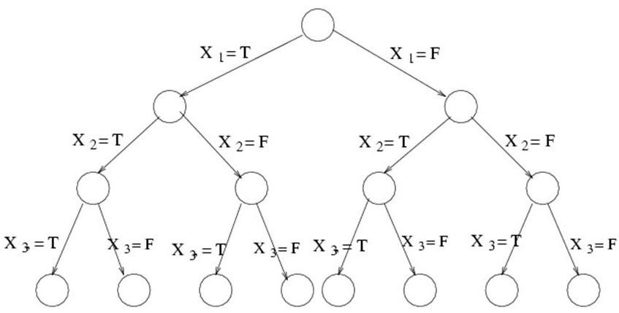
Time Complexity
(A Research Problem)

Slide 15
Time Complexity
(A Research Problem)
NP-Hard: A problem is NP-hard (Non-deterministic Polynomial-time hard) if it is at least as hard as the hardest problems in NP.
CNF Satisfiability is NP-hard problem. If a problem can be reduced to CNF Satisfiability problem, then it is also NP-Hard problem.
Reduction: If you can related an instance of problem x to instance of CNF Satisfiability, then it means problem x is reduced to CNF Satisfiability.
NP-Complete: A problem is NP-complete (Non-deterministic Polynomial-time complete) if it is NP-hard and it has non-deterministic polynomial time algorithm, then it is NP-Complete problem.
CNF Satisfiability is NP-complete problem.

Slide 16
Time Complexity
(A Research Problem)
Cook-Levin theorem: It is in NP, and any problem in NP can be reduced in polynomial time by a deterministic Turing machine to the Boolean satisfiability problem.
An important consequence of this theorem is that if there exists a deterministic polynomial-time algorithm for solving Boolean satisfiability, then every NP problem can be solved by a deterministic polynomial-time algorithm.

Slide 17
Cook-Levin theorem
Cook-Levin theorem: It is in NP, and any problem in NP can be reduced in polynomial time by a deterministic Turing machine to the Boolean satisfiability problem.
An important consequence of this theorem is that if there exists a deterministic polynomial-time algorithm for solving Boolean satisfiability, then every NP problem can be solved by a deterministic polynomial-time algorithm.

Slide 18
Vertex Cover problem
Vertex cover: In graph theory, a vertex cover of an undirected graph is a set of vertices such that each edge of the graph is incident to at least one vertex in the set. In other words, it is a set of vertices that "covers" all the edges by having at least one endpoint of each edge.
The Vertex Cover problem is the decision problem associated with finding a vertex cover of minimum size in a given graph.

Slide 19
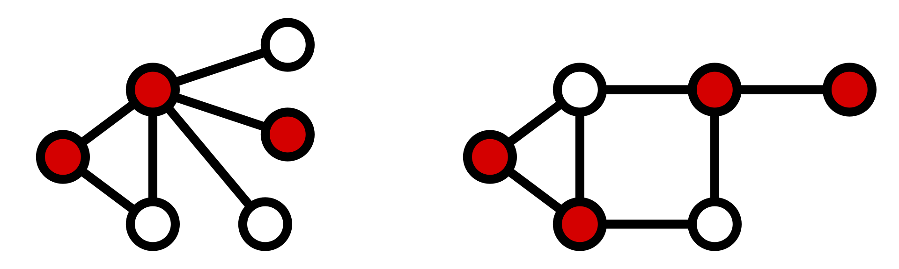
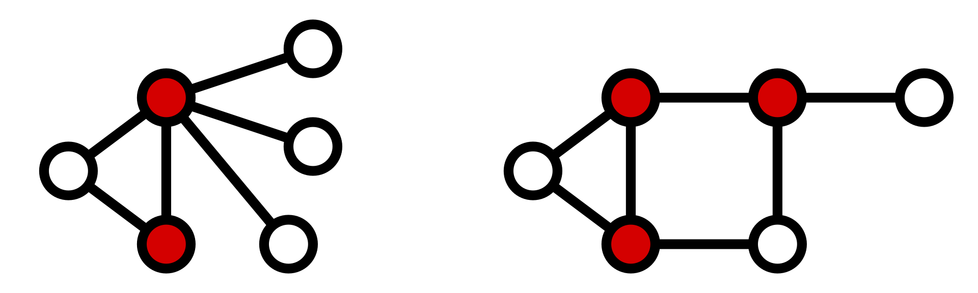
Vertex Cover problem

Slide 20
Clique Problem
In graph theory, a clique in an undirected graph is a subset of vertices, all of which are adjacent to each other. In other words, a clique is a complete subgraph, meaning that every pair of distinct vertices in the clique is connected by an edge.
The Maximum Clique problem is a computational problem that seeks to find the largest possible clique in a given graph.

Slide 21
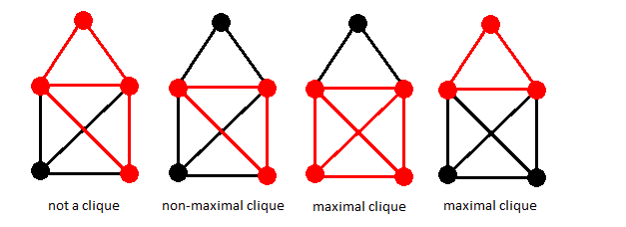
Clique Problem

Slide 22
Other problems
Subset-Sum Problem:
Input: A set of positive integers S={a1​,a2​,…,an​} and a target sum K.
Output: Does there exist a subset A⊆S such that the sum of elements in A is exactly K?
Knapsack Problem:
Input:
A set of n items, each with a weight wi​ and a value vi​, i=1,2,…,n.
A maximum weight capacity W.
Output:
Find the most valuable combination of items that can be accommodated in the knapsack without exceeding its weight capacity.
While dynamic programming algorithms can efficiently solve many instances of the 0/1 Knapsack Problem, the general problem is considered computationally difficult in the worst case.

Slide 23
Other problems
Hamiltonian Cycle Problem:
A Hamiltonian Cycle in a graph is a cycle that visits every vertex exactly once and returns to the starting vertex.
Problem: Does there exist a Hamiltonian Cycle in graph?
Traveling Salesman Problem (TSP):
Input: A set of n cities. The distance or cost between each pair of cities.
Output: Find the shortest possible tour that visits each city exactly once and returns to the starting city.
TSP Decision Problem: The decision version of the problem is to determine whether there exists a tour of a given length or less.
TSP Optimization Problem: The optimization version involves finding the tour with the minimum total distance or cost.

Slide 24
References
Algorithms Design: Foundations, Analysis and Internet Examples Michael T. Goodrich, Roberto Tamassia, 2006, Wiley (Students Edition)
Data Structures, Algorithms and Applications in C++, Sartaj Sahni, Second Ed, 2005, Universities Press
Introduction to Algorithms, TH Cormen, CE Leiserson, RL Rivest, C Stein, Third Ed, 2009, PHI

Slide 25
Any Question!!

Slide 26
Thank you!!

